Slide 1
Geological Image Retrieval
Present by: Iman Zabett

Slide 2
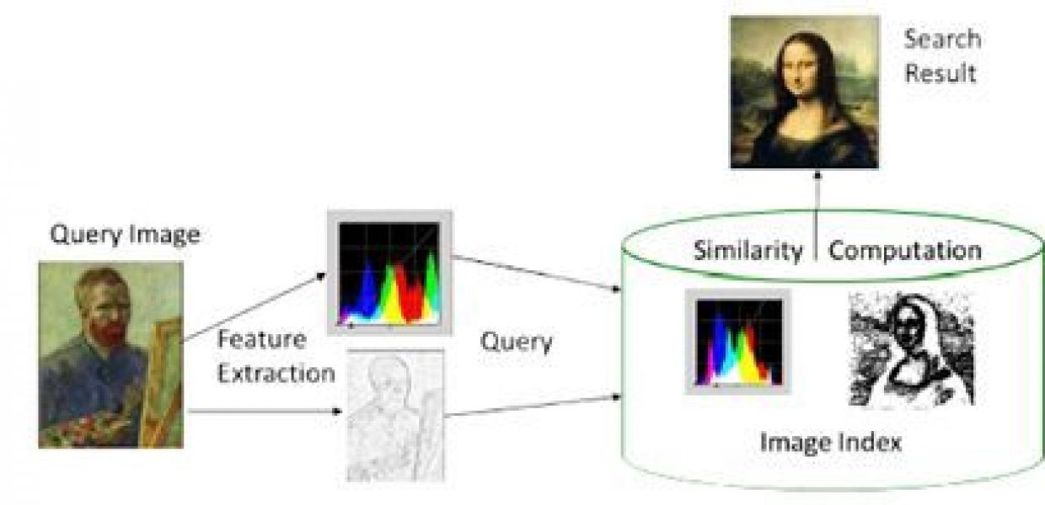
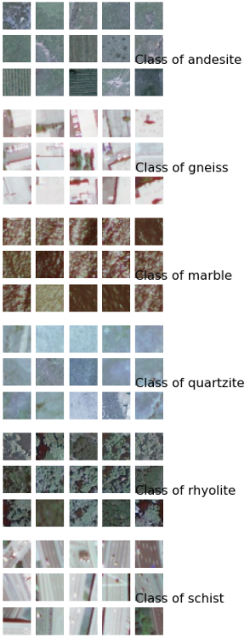
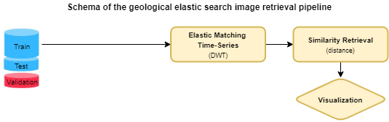
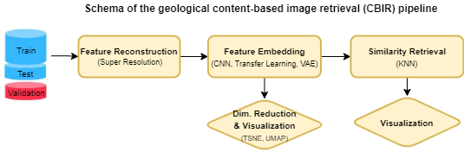
Geological Image retrieval Approaches
In the area of computer vision and data mining, image retrieval is one of the hot area. We are given an image from the user. We have a large set of images available to us. We want to compute similar images to the given image. There are two main approaches to find similar images:
1- elastic matching of a time series, which is a method widely used in voice recognition and time series comparison.
2- content-based image retrieval (CBIR) tools such as comparison of wavelets, Fourier analysis, or pattern recognition with neural networks.
However, these methods cause a loss of a lot of the image information, or need an extensive training similar to the neural networks.
The most used method is the description-based image retrieval using metadata associated with the images, but in an unknown dataset, this method is not effective.
In this work, three methods have been used:
1- Unsupervised approach variational autoencoder (VAE)
2- Semi-supervised approach Perceptual VAE
3- Supervised approach of Transfer Learning with VGG network
Content-Based image retrieval schema
Overview of Geo dataset with six classes
Notes:
Give an overview about the problem and what kind of solutions I am looking at
Briefly describe about the approaches and each adv/disadv.

Slide 3
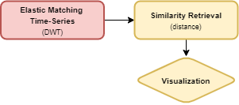
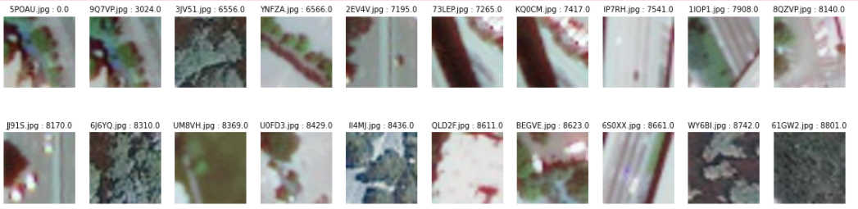
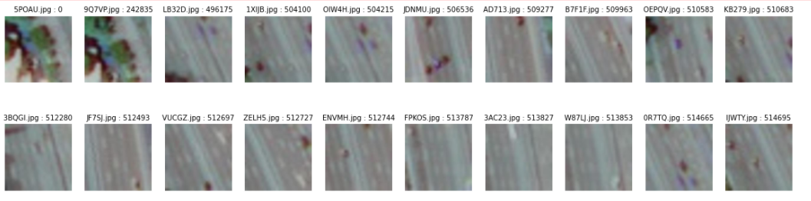
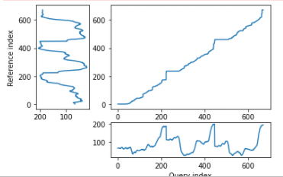
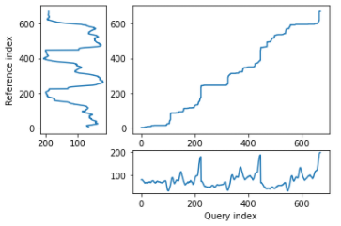
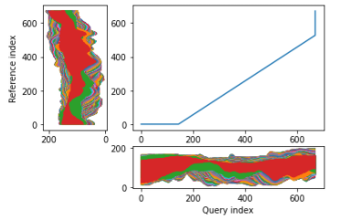
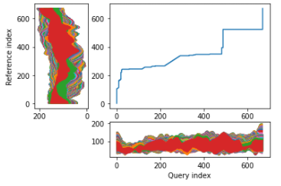
Dynamic time warping (DTW)
Notebook DTW
Dynamic time warping (DTW)* is an elastic matching algorithm used in pattern
recognition. DTW finds the optimal warp path between two time series. DTW is used
as a distance metric, often implemented in speech recognition, data mining, robotics,
and in this case image similarity
There are some advantages and disadvantages for this:
No need to use of any metadata
No need to use concept-based image indexing
Time consuming
not reproducible
Two methods for extracting data from image have been used. Quick method which is only extract slice of 3-CH matrix which dramatically reduced runtime of search through geo dataset (~ 13 min). And Exhaustive method which uses entire data (3-CH matrix) of images, which requires high amount of time to search through entire geo dataset (~ 1 hour). The images show the comparisons between 20 most similar images regarding to two methods and below shows the comparison between their 2-way plots for two sample image w.r.t. the query image (first image of the row)
Other image Similarity Metrics using in this work:
- Peak Signal to Noise Ratio (PSNR)
Structural SImilarity Method (SSIM)
*Reference: Lei, Hansheng, and Venu Govindaraju. "Direct image matching by dynamic warping." In 2004 Conference on Computer Vision and Pattern Recognition Workshop, pp. 76-76. IEEE, 2004.
Quick DTW
Exhaustive DTW
Quick DTW
For 9Q7VP and
3JV51
Query: 5POAU
Exhaustive DTW
For 9Q7VP and
3JV51
Query: 5POAU
Notes:
The most traditional estimator is mean-square error (MSE). MSE measures the average squared difference between the estimated values (predicted values) and the actual value (ground truth). So we just calculate squared differences pixel by pixel. But this works well only if we want to generate a picture with the best pixel colors conformity with the ground truth picture. Sometimes we want to concentrate on the structure or relief of the picture.
PSNR (Peak Signal to Noise Ratio) is the second traditional estimator. To use this estimator we must transform all values of pixel representation to bit form. If we have 8-bit pixels, then the values of the pixel channels must be from 0 to 255. By the way, the red, green, blue or RGB color model fits best for the PSNR. PSNR shows a ratio between the maximum possible power of a signal and the power of corrupting noise that affects the fidelity of its representation. PSNR is often used to control the quality of digital signal transmission.
But PSNR is a variation of the MSE and still concentrates on pixel-by-pixel comparison. Let’s consider the structural similarity method (SSIM). SSIM is correlated with the quality and perception of the human visual system (HVS color model). Instead of using traditional error summation methods, the SSIM models image distortion as a combination of three factors that are loss of correlation/structure, luminance distortion, and contrast distortion.

Slide 4
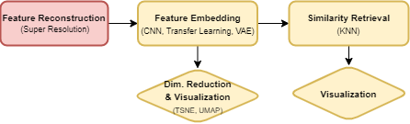
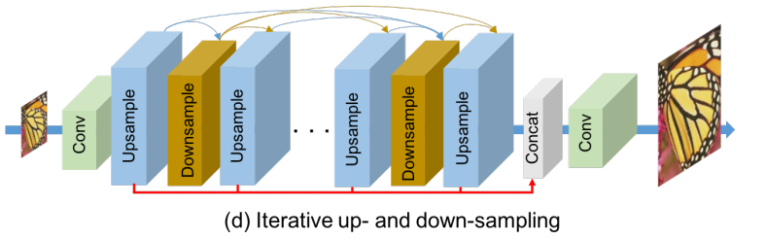
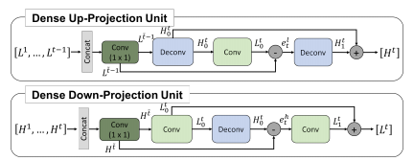
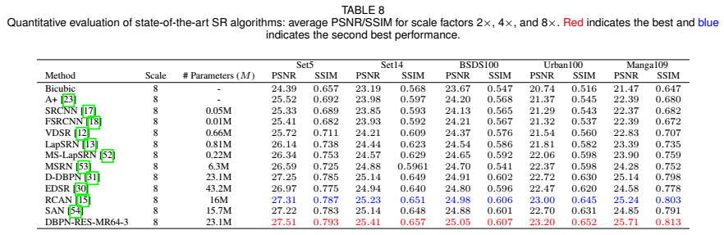
Super Resolution Deep Back-Projection Networks (DBPN) for Single Image Super-resolution
Motivation:
We have very low information of our experimental dataset.
The proposed dataset contains very low resolution images representing six different geological patterns.
For example we don’t know how big the actual images, or the images are tiles of a bigger image. If they have been down-sampled, how many times they have lower resolution than their actual size.
Or even we don’t know how close they have been photographed (are they satellite images or close-up images)
DBPN: Consists of three main phases:
Initial feature extraction with Conv layer,
Back-projection with multiple dense up-/down- projection units to form feature maps (HR and LR)
scale up/down, scale down/up, clac residual, scale residual up/down, output feat map
Image reconstruction by concatenating feature maps produced in projection units and a conv layer
Reference: Haris, Muhammad, Greg Shakhnarovich, and Norimichi Ukita. "Deep back-projection networks for single image super-resolution." arXiv preprint arXiv:1904.05677 (2019).

Slide 5
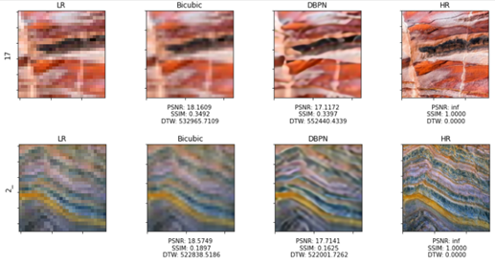
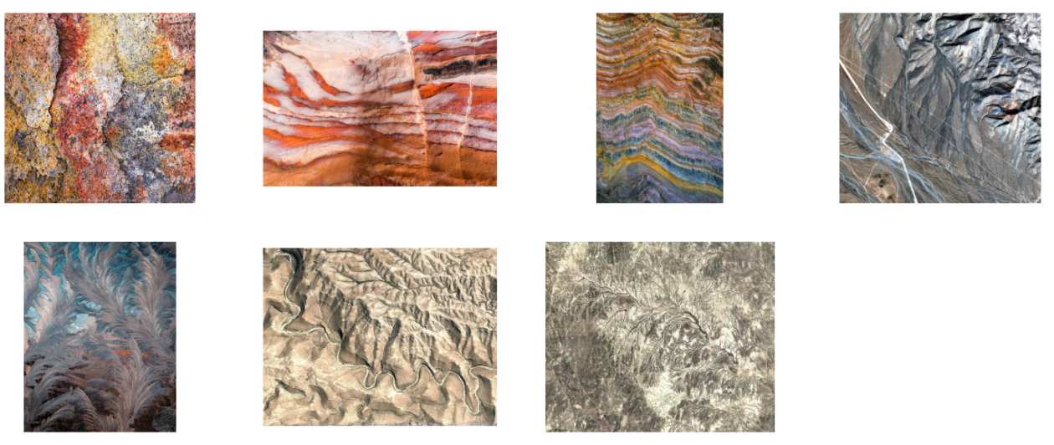
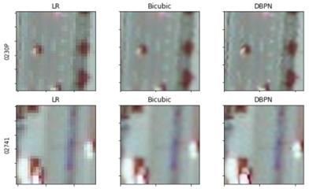
Super Resolution (Contd) Notebook link
Comparison between DBPN and Bicubic approach to reconstruct high resolution image
Motivation:
The DBPN model has been trained with variety of high resolution images (DIV2K). Then the pretrained model used to
A comparison has been made over cropped images from high-resolution geological images
Cropping from HQ images to 224*224 make the HR images (4th column)
Down-scaling the HR cropped for 24*24 and make LR images (1st column)
Up-scaling the first column with Bicubic and make the 2nd column
Up-scaling the first column using DBPN model and make the 3rd column
Apply DBPN on our Geo dataset samples
Crop from the HQ images to test model
Preview of HQ geological images

Slide 6
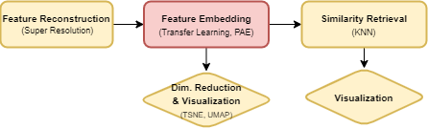
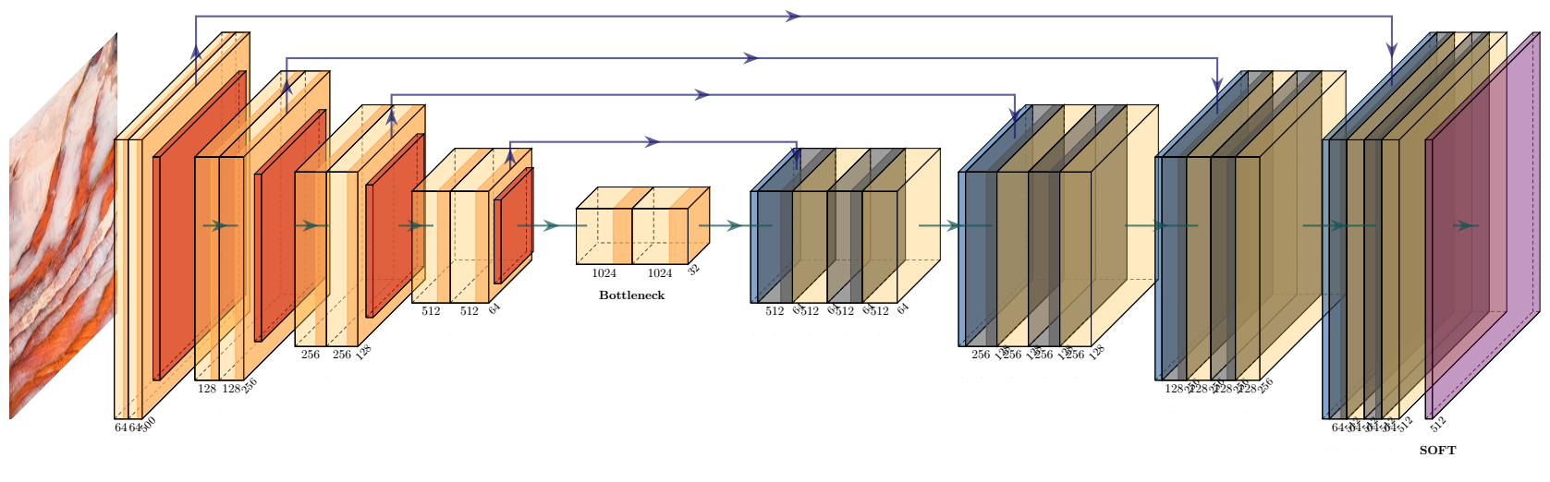
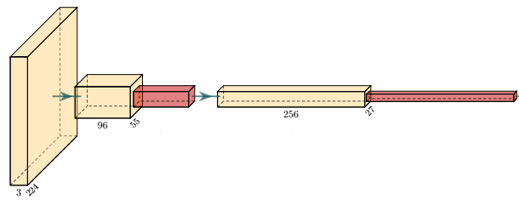
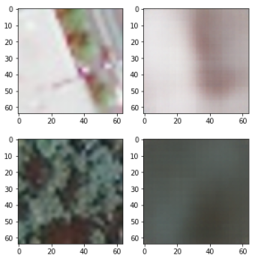
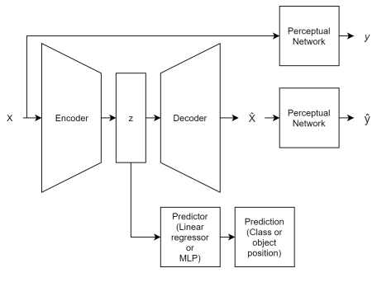
Perceptual Autoencoder Notebook link
perceptual loss recently proposed as an alternative to element-wise loss to improve autoencoder embeddings for downstream prediction tasks.
In this approach, the perceptual network has been developed as follows:
an Alexnet has been trained with train Geo dataset with up to %97.50 accuracy
Then only the first two layers of feature layers of the Alexnet was used
A sigmoid function has been added after the last RELU layer
Then the perceptual network was used follow with the variational autoencoder, to get the constructed images of the VAE as an input. This forms the state-of-the-art P-VAE network that can be trained against the training geo dataset.
Reference: Pihlgren, Gustav Grund, Fredrik Sandin, and Marcus Liwicki. "Improving image autoencoder embeddings with perceptual loss." In 2020 International Joint Conference on Neural Networks (IJCNN), pp. 1-7. IEEE, 2020.
Variational Autoencoder
Perceptual Network Alexnet (2 feature layers + sigmoid func)
Sample of input and reconstructed image of VAE
Schema of Perceptual VAE network
Notes:
Autoencoder: Autoencoders consist of two main components, convolutional layers as encoder, and deconvolutional layers as decoder. They have been commonly used for feature learning and dimensionality reduction, generative modeling, denoising, generating sparse representations, anomaly detection . The reduced dimensions are referred to as the latent space, embedding, or simply as z.
Variational Autoencoder: In VAEs, the encoder generates a mean and variance of a Gaussian distribution per dimension instead of an embedding. The embedding is then sampled from those distributions to find N(mean=0,var^2=1). To prevent the model from setting the
variance to 0 a regulatory loss based on Kullback-Liebler (KL) divergence is used. KL divergence is simply an extension of Entropy measure to find dissimilarity between two probability distributions.
This is a regulatory loss which is calculated between the generated Gaussian distributions and a Gaussian with mean 0 and variance 1. Through this the VAE is incentivized not only to create embeddings that contain information about the data, but that these
Jensen-Shannon Divergence: Extension of KL divergence
Element-wise Loss (in Computer vision - pixel-wise loss ): The difference between output and input is quantified by a loss function, if the goal of each output unit is to reconstruct exactly the corresponding target, is known as element-wise loss. Eg: Mean Squared Error (MSE).
Problems: 1- doesn’t see the pattern but compare pixel-wise 2- all elements are weighted equally although some may more important (eg: object detection tasks - missing an object)
Perceptual loss: is calculated using the activations of an independent neural network, called the perceptual loss network

Slide 7
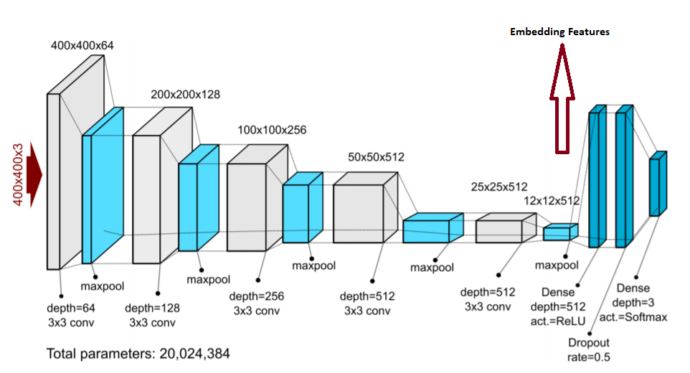
Transfer Learning Notebook link using VGG19bn
The VGG-19 CNN architecture is reported to achieve high accuracies for image processing large datasets such as ImageNet. VGG-19 model has roughly 143 million parameters. The VGG-19 contains 19 trainable layers including convolutional and fully connected layers as well as max pooling, and dropout.
Batch normalization (also known as batch norm) is an accelerate method used to make deep neural networks faster and more stable through normalization of the input layer by re-centering and re-scaling.
The training over the geo dataset after 50 epochs, achieved up to %99 accuracy over the test dataset. The VGG19bn has been modified to classify for 6 classes. After training, the features (after the last feature layers) will be extracted for validation dataset in order to retrieve the most similar images
Architecture of VGG19bn

Slide 8
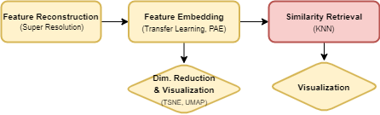
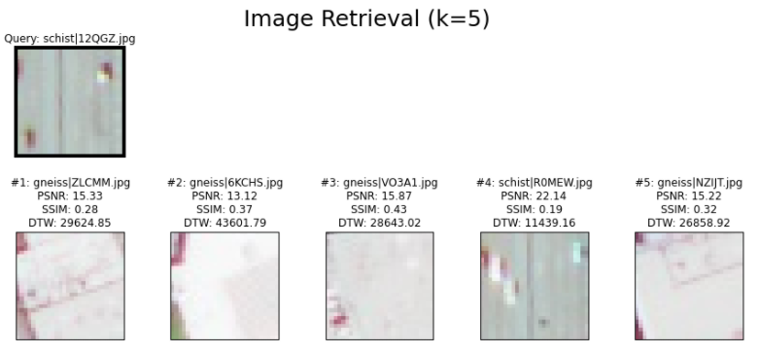
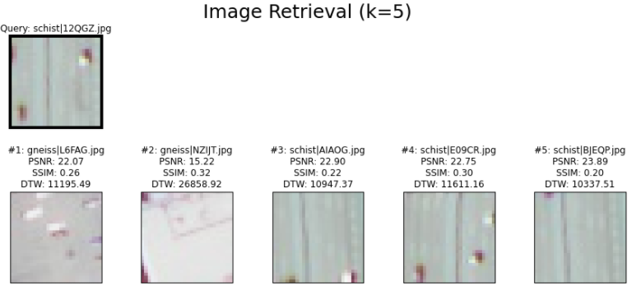
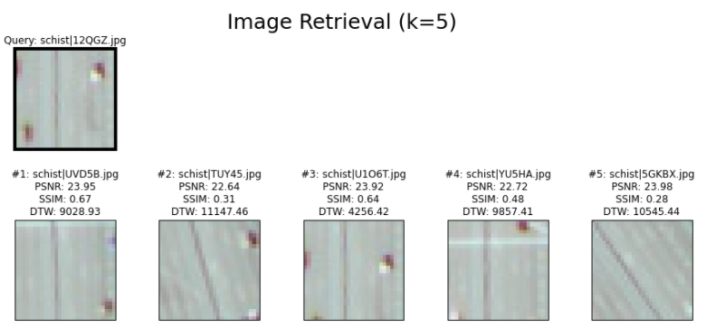
Similarity Retrieval with KNN comparisons between VAE, P-VAE, and VGG19bn
Notebook VAE
Notebook P-VAE
Notebook VGG19bn
The comparison is being made using an image query.
Then K-Nearest Neighbor (KNN) is being use to find the closest images in the feature spaces.
The feature space for VAE (128 dimensions), P-VAE (128 dimensions), and VGG19bn (2048 dimensions).
The entire train geo set is used to fit the KNN with “cosine” metric to calculate the distance of samples.
There are three similarity metrics (PSNR, SSIM, DTW) being used to calculate similarity of each retrieved images (nearest images) with the query image.
The result shows that VGG19bn has better overall performance over P-VAE and P-VAE has better overall performance over VAE.
VAE image retrieval
P-VAE image retrieval
VGG19bn image retrieval

Slide 9
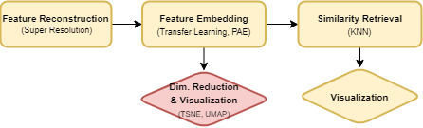
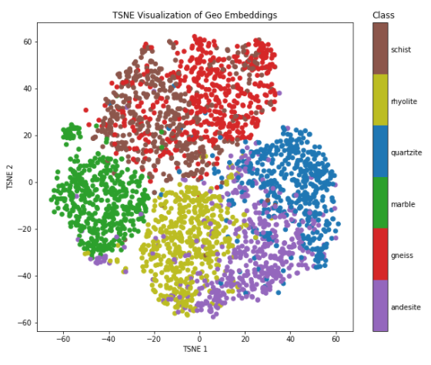
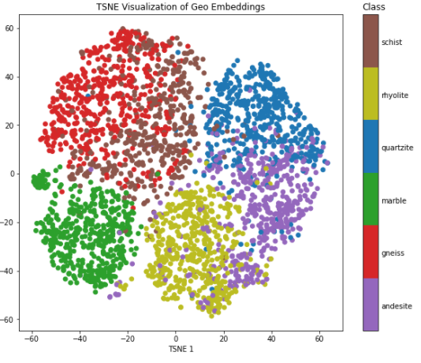
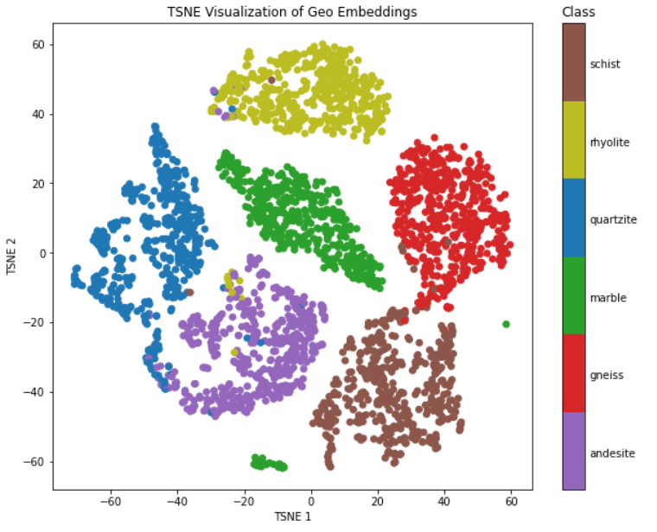
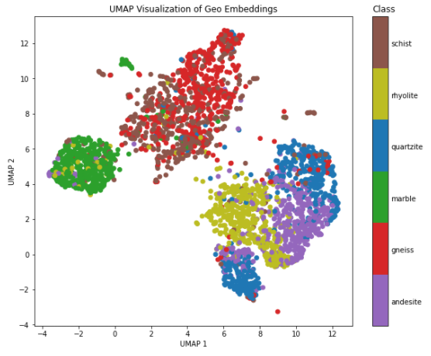
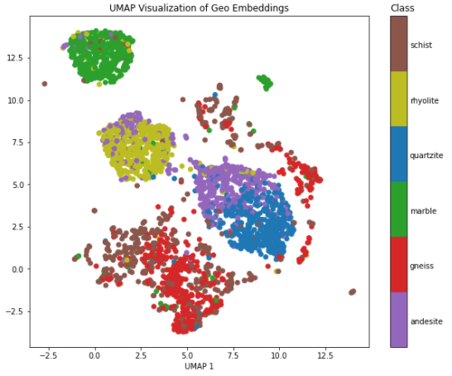
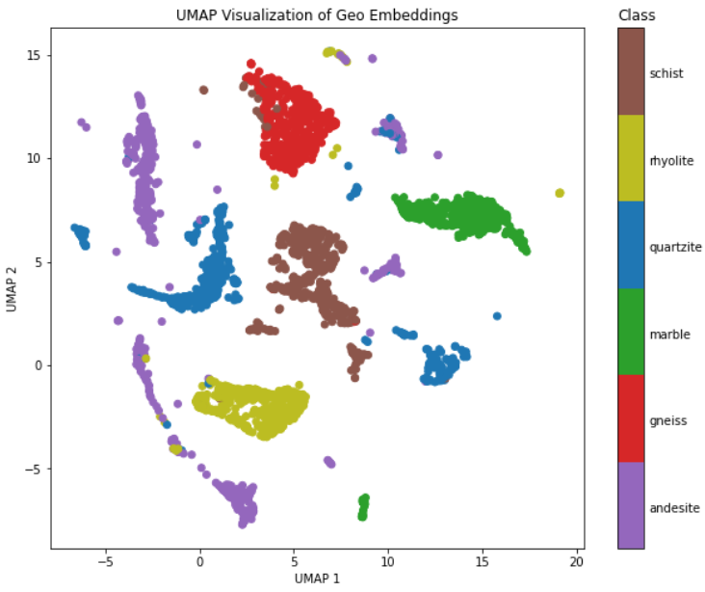
Dimensionality Reduction for Visualization
t-Distributed Stochastic Neighbor Embedding (t-SNE)
TSNE takes much longer and is designed to retain local structure within the data.
The transformation has done for entire data (trian + test) features, since there is no “transform” function to transform test features after building TSNE embedding model. The visualization however is only for test features in 2D plane.
Uniform Manifold Approximation and Projection (UMAP)*
UMAP is generally quicker and is designed for a balance between local density and global/topological structure in the embedding. Also “transform” is available.
The algorithm is founded on three assumptions about the data:
The data is uniformly distributed on a Riemannian manifold;
The Riemannian metric is locally constant (or can be approximated as such);
The manifold is locally connected.
Results
The results show that UMAP had better performance to maintain global structure. Also VGG19bn (transfer learning) outperforms over VAE and P-VAE in order to have distinct clusters of classes with enough distance from other classes
* Reference: Parra-Hernández, Ronald M., Jorge I. Posada-Quintero, Orlando Acevedo-Charry, and Hugo F. Posada-Quintero. "Uniform Manifold Approximation and Projection for Clustering Taxa through Vocalizations in a Neotropical Passerine (Rough-Legged Tyrannulet, Phyllomyias burmeisteri)." Animals 10, no. 8 (2020): 1406.
TSNE/UMAP for VAE
TSNE/UMAP for P-VAE
TSNE/UMAP for VGG19bn
Notes:
UMAP is constructed from a theoretical framework based in Riemannian geometry and algebraic topology.

Slide 10
Thank you!

